Slide 1
80 to 0 in under 5 seconds: Falsifying a medical patient's vitals
Douglas McKee

Slide 2


Who am i?
Douglas McKee
Senior Security Researcher for McAfee’s Advanced Threat Research team
8+ years experience in vulnerability research, penetration testing and forensics
@fulmetalpackets
Not a medical doctor

Slide 3

Outline
Why these medical devices?
Overview of systems
RWHAT?
Reversing the protocol
Replay attacks
Demo
Impact Scenarios
Mitigations

Slide 4

Why?
Potential impact of medical devices
Patient monitoring will always be a necessary
“Vital signs are integral to clinical decision making” – Dr. S. Nordeck
Reliance on technology in medical field
"We have an implicit trust in these types of technologies," Tully says. "We don’t ever get any cybersecurity training in medical school. It’s not something that ever comes up in our literature." Dr. Jeff Tully*
*https://www.hpe.com/us/en/insights/articles/medical-device-security-hacking-prevention-measures-1806.html
Notes:
Use of technology to obtain vital signs is ubiquitous to all medical practices from the office, to ER, to hospital floors and a reason for choosing this project. Furthermore, Vital signs have a large impact on clinical decision making and I agree with Dr. Tully that as physicians, we implicitly trust these devices to be accurate and have no consideration or training on potential cyber threats.

Slide 5
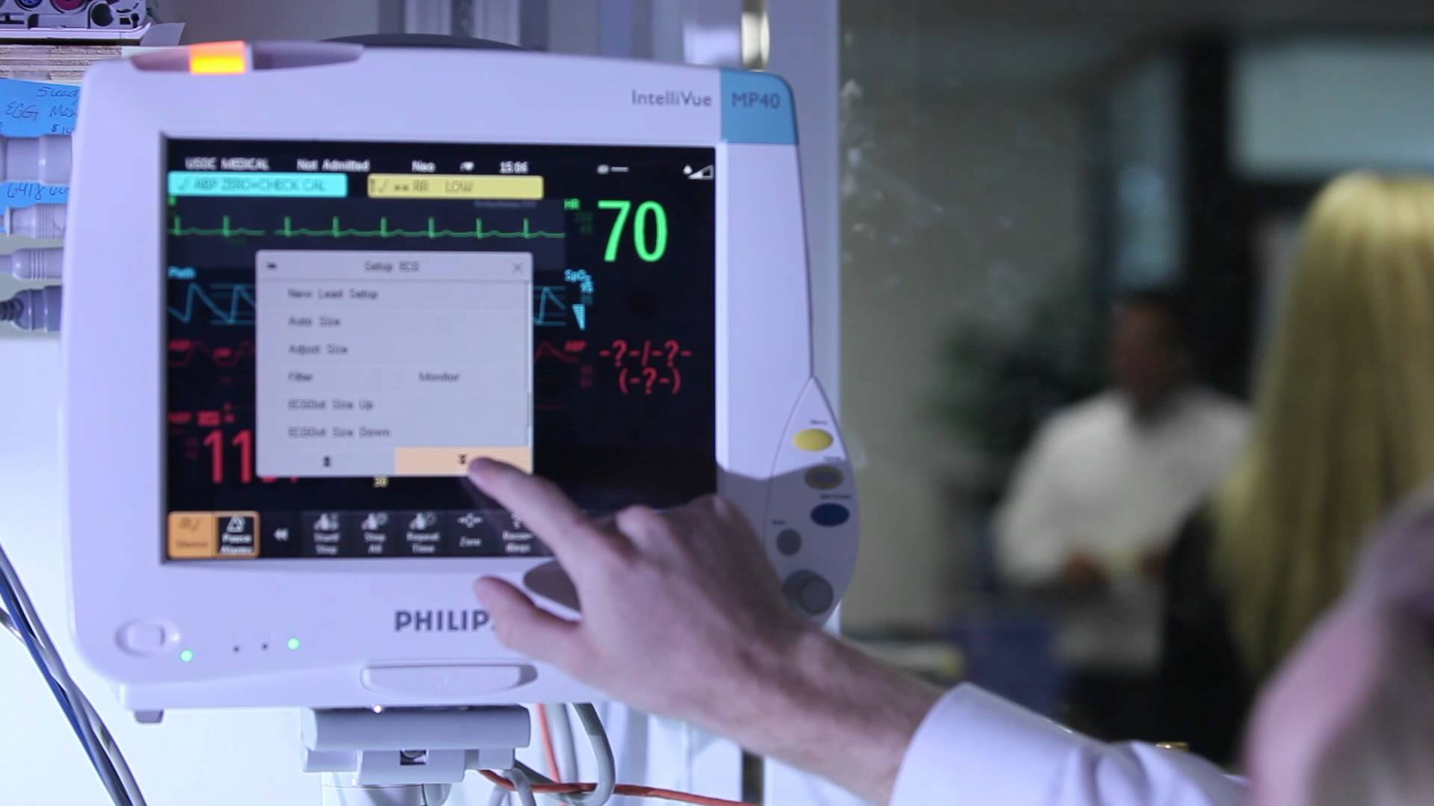
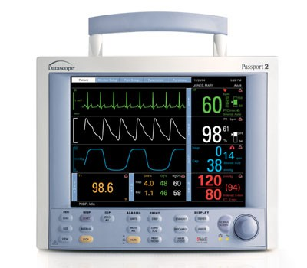
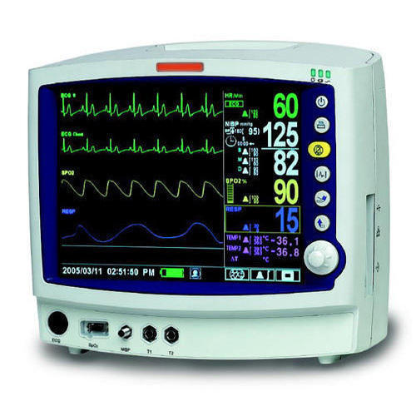
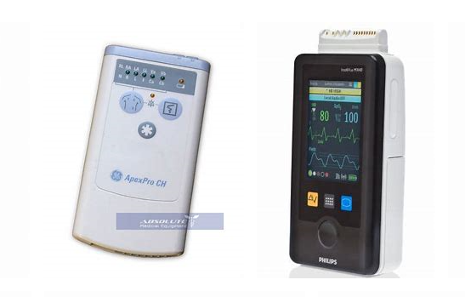
Patient Monitor (PM)
Bedside monitor
Monitors patient’s vitals – Heartrate, Blood pressure, O2 levels, etc
Has wired and wireless (optional) networking
Contains Personal Identifiable Information (PII)
*General pictures, not tested model
Notes:
The most common type of monitor for obtaining vital signs is a bedside patient monitor. These are found in every ER room and almost every room in the hospital and obtain the heart rhythm and rate, blood pressure, oxygen saturation, in addition to multiple other metrics. There are also wireless telemetry boxes, bottom right corner, which capture and report the same information. These devices are programed with the patient’s information such as name, date of birth, medical record number, room number, and transmit their data via wired or wireless connection to a central monitoring station and occasionally the medical record.

Slide 6

Central Monitoring Station (CMS)
Runs Embedded Windows on CF Card
Windows XP or Windows 7
Has two Ethernet ports for two networks
Runs main application in limited user mode
A central station that receives data from Patient Monitors
Thanks Ebay!
Notes:
A central monitoring station captures and displays all the vitals from each patient monitor connected. This station is usually centralized at a nursing station or in a dedicated telemetry room on a patient floor. The central monitoring station is generally connected via ethernet but may also be wireless. The system runs XP or 7. As in this picture, there is usually a tech who monitors the rhythms and will alert the physician if abnormalities are seen. There is also the ability to record event and print out the EKG strip when abnormalities occur.
- Back to Doug - don't advance slide

Slide 7
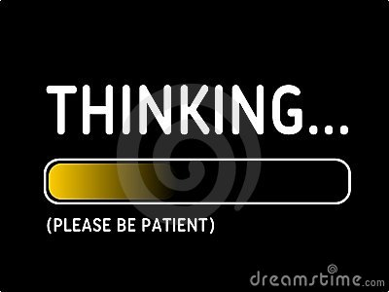
Potential Attack vectors
OS
Application
Notes:
Windows XP itself is a vulnerability.
Explain why started with networking and reasons for not starting with others.
OLD OS boring and have there own problems
Hardware may require physical access, so lets start with networking, and see if that can affect both

Slide 8
Potential Attack vectors
OS
Application
Firmware/hardware
Network
Modify patient information?
Notes:
Windows XP itself is a vulnerability.
Explain why started with networking and reasons for not starting with others.
OLD OS boring and have there own problems
Hardware may require physical access, so lets start with networking, and see if that can affect both

Slide 9
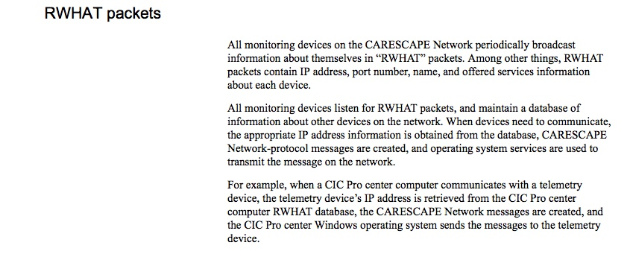
RWHAT?
Notes:
RWHAT dll on CMS

Slide 10
RWHAT?
Notes:
RWHAT dll on CMS

Slide 11
Testing Setup
Notes:
Build up to Charles slide - not only did Charles get sick of being monitored by a device I was trying to hack, I got tired of looking at his nipples. So, I bought a very nipple-free ECG to generate human-equivalent heartbeats and other vitals.
- Found out we actually have these in the wrong places…..like completely wrong 3 of 5 are in the wrong place

Slide 12
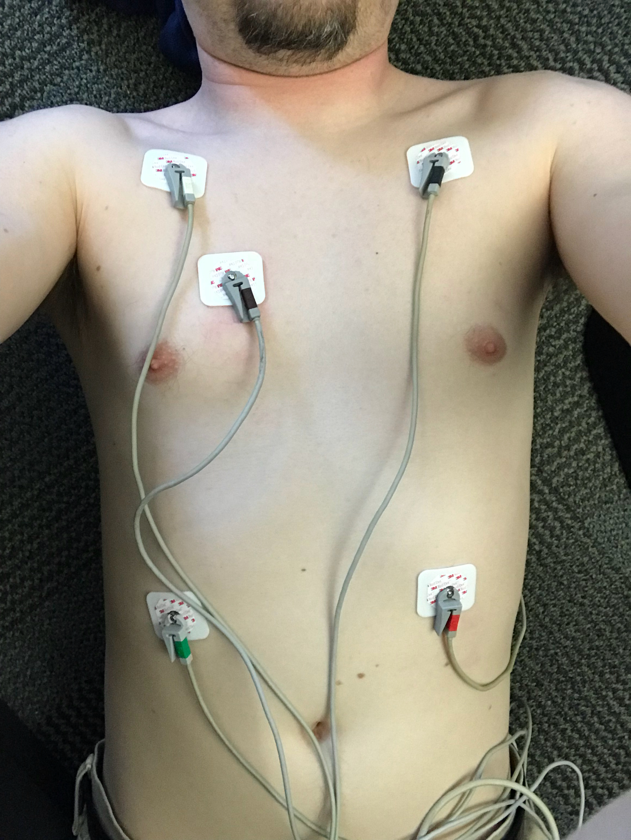
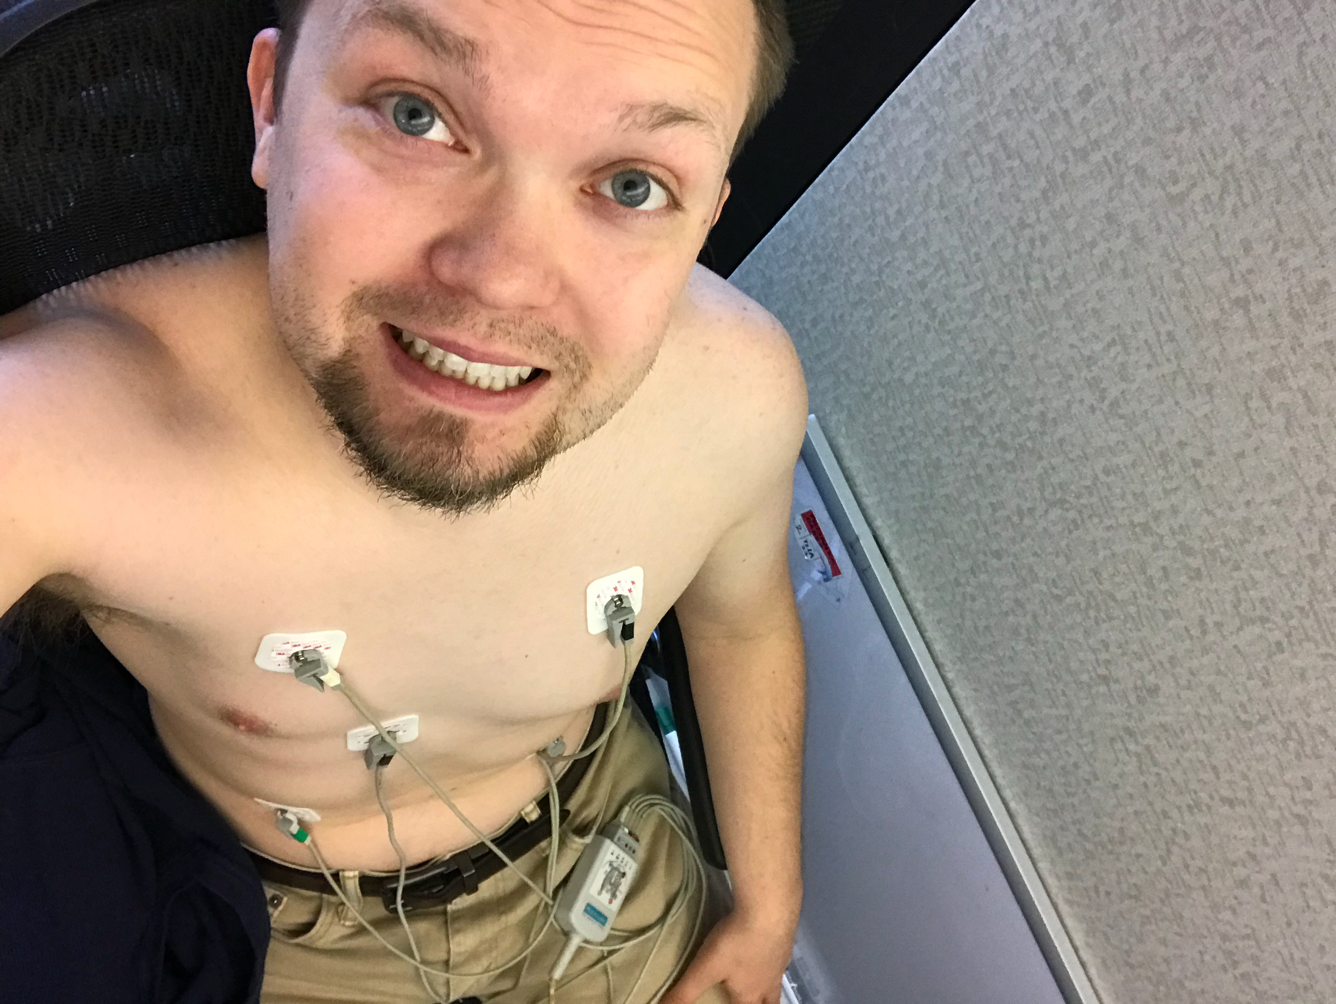
Testing Setup
Notes:
Build up to Charles slide - not only did Charles get sick of being monitored by a device I was trying to hack, I got tired of looking at his nipples. So, I bought a very nipple-free ECG to generate human-equivalent heartbeats and other vitals.
- Found out we actually have these in the wrong places…..like completely wrong 3 of 5 are in the wrong place

Slide 13
Testing Setup
Notes:
Build up to Charles slide - not only did Charles get sick of being monitored by a device I was trying to hack, I got tired of looking at his nipples. So, I bought a very nipple-free ECG to generate human-equivalent heartbeats and other vitals.
- Found out we actually have these in the wrong places…..like completely wrong 3 of 5 are in the wrong place

Slide 14
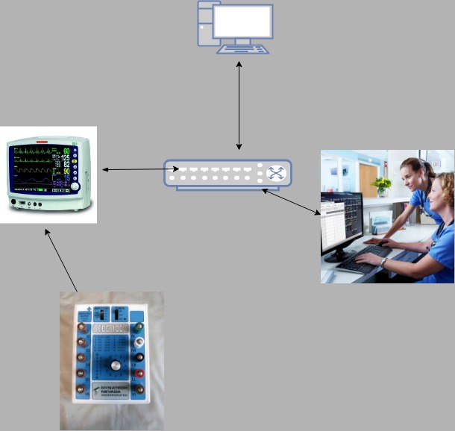
Improved Testing setup
Notes:
Computer – Send/Sniff
ECG – generate wave pattern send to PM
PM – collect data and send to CMS if CMS is accepting
CMS – broadcast and receive

Slide 15
CMS IDLE Packets

Slide 16
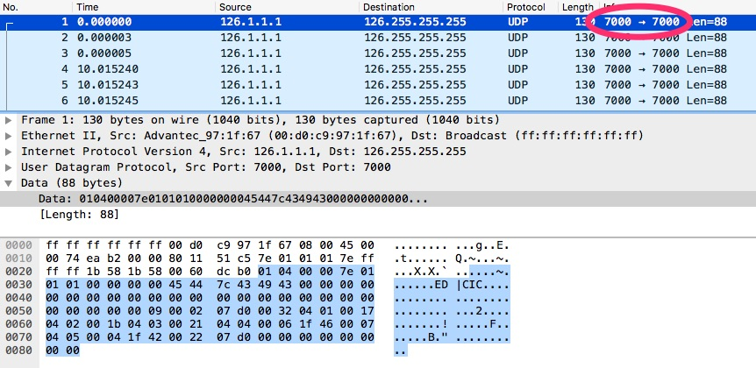
CMS IDLE Packets
CMS broadcast port

Slide 17
CMS IDLE Packets
CMS broadcast port
Every 10 seconds

Slide 18
CMS IDLE Packets
CMS broadcast port
Every 10 seconds
Identifies name

Slide 19
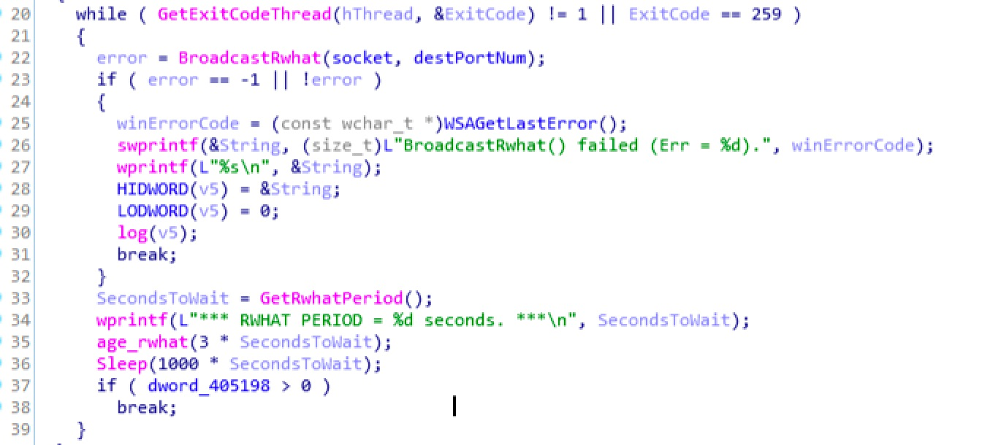
CMS IDLE Packets

Slide 20
CMS IDLE Packets

Slide 21
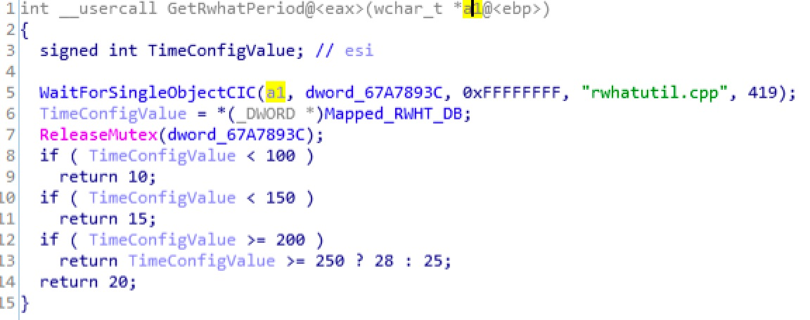
CMS IDLE Packets

Slide 22
CMS IDLE Packets

Slide 23
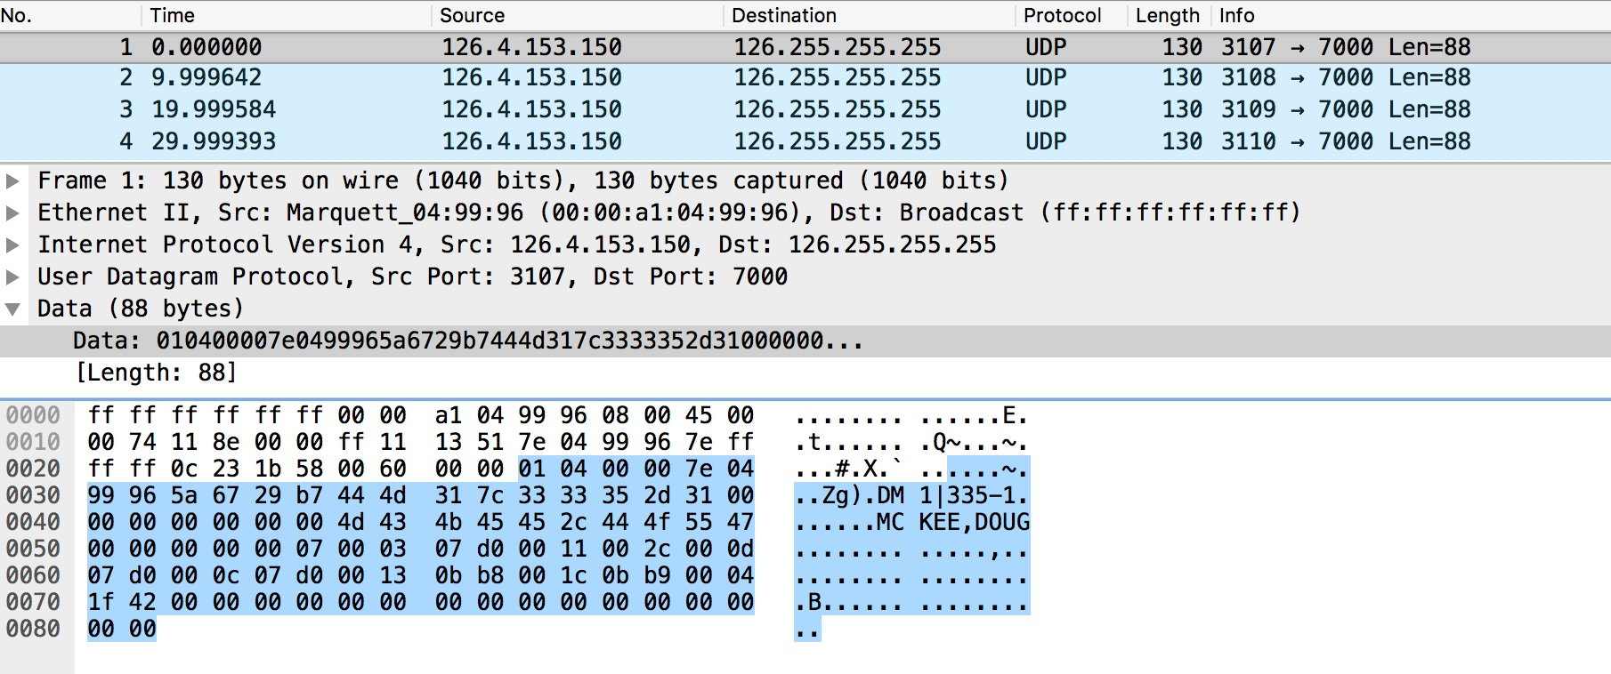
PM Idle/Broadcast Packets
Every 10 seconds
Src Ports increment
Counter by 0xA
Patient Info
Notes:
Show ida screen shots of
Parsing moitor name
Reading db to determine how often to send packets
Opening new port each time, resulting in port higher
Did you fuzz or attempt to test the bounds on any of the variables passed to the widechar strcpy? Patient name, beds, etc...

Slide 24
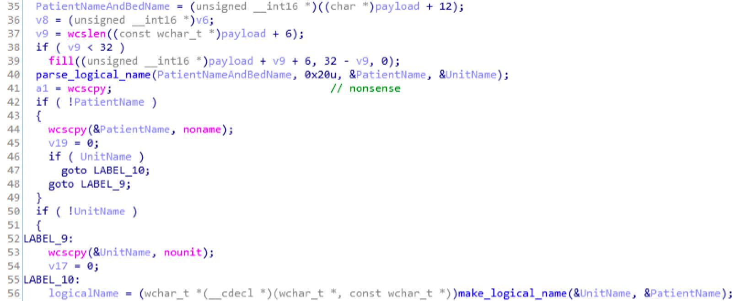
PM Idle/Broadcast Packets
Notes:
Show ida screen shots of
Parsing moitor name
Reading db to determine how often to send packets
Opening new port each time, resulting in port higher
Did you fuzz or attempt to test the bounds on any of the variables passed to the widechar strcpy? Patient name, beds, etc...

Slide 25
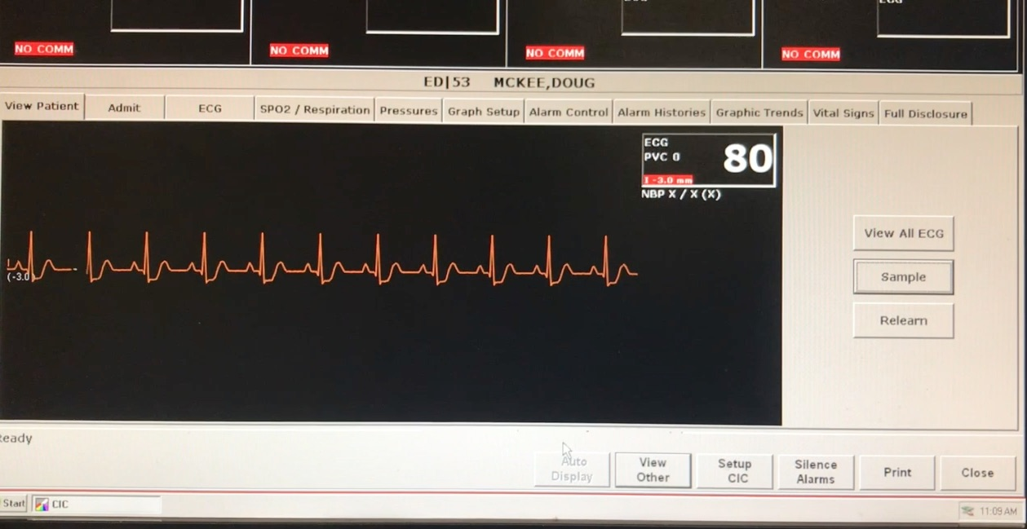
CMS – Normal operation with ECG Simulator

Slide 26
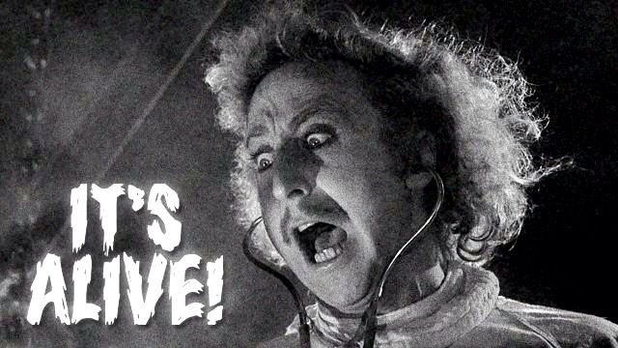
CMS – Normal operation with ECG Simulator

Slide 27
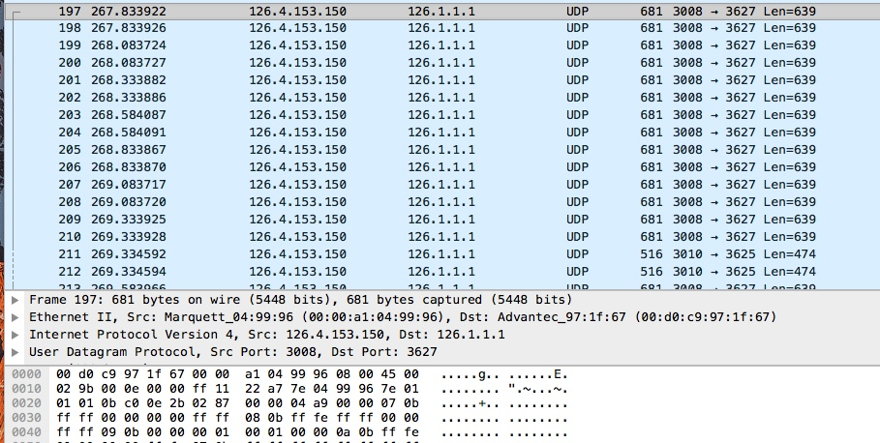
Normal Traffic
Notes:
Explain steps to open monitor in CMS and how there is no traffic besides broadcasts – this traffic happens upon selecting monitor and seeing previous slide

Slide 28
Normal Traffic
PM
Notes:
Explain steps to open monitor in CMS and how there is no traffic besides broadcasts – this traffic happens upon selecting monitor and seeing previous slide

Slide 29
Normal Traffic
CMS
PM
Notes:
Explain steps to open monitor in CMS and how there is no traffic besides broadcasts – this traffic happens upon selecting monitor and seeing previous slide

Slide 30
Normal Traffic
CMS
PM
Data Packets
Notes:
Explain steps to open monitor in CMS and how there is no traffic besides broadcasts – this traffic happens upon selecting monitor and seeing previous slide

Slide 31
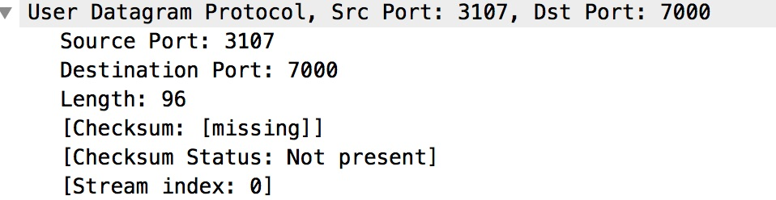
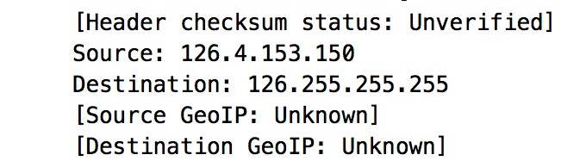
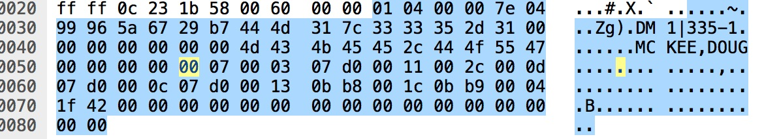
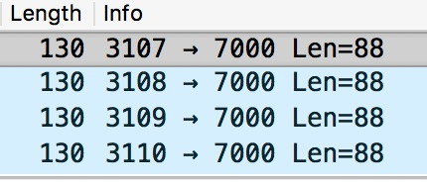
Basic observations
UDP Packets
Utilization of Broadcast address
Counters
Varying Port numbers
Not encrypted

Slide 32
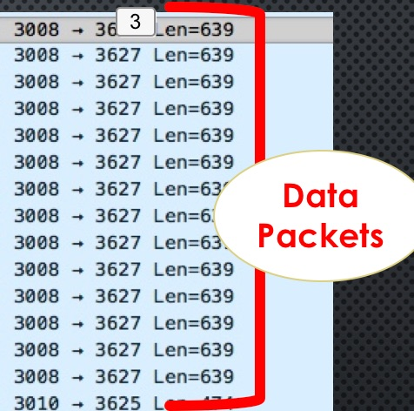
Basic observations
UDP Packets
Utilization of Broadcast address
Counters
Varying Port numbers
Not encrypted
Data Packets

Slide 33

Basic observations
UDP Packets
Utilization of Broadcast address
Counters
Varying Port numbers
Not encrypted
Data Packets
Replay attack ?

Slide 34
Simple Replay!!!!
Notes:
Explain simple replay attacks with tools such as udpreplay fail, using scapy to straight replay packets fail

Slide 35

Simple Replay!!!!
Notes:
Explain simple replay attacks with tools such as udpreplay fail, using scapy to straight replay packets fail

Slide 36
Understanding the packets: Handshake
Notes:
Ok easy enough lets make a scapy script todo this. FAIL more info in packets that matter
Make it clear that the fake S, S/A, A is still UDP and connectionless, just represents a handshake type of structure.

Slide 37
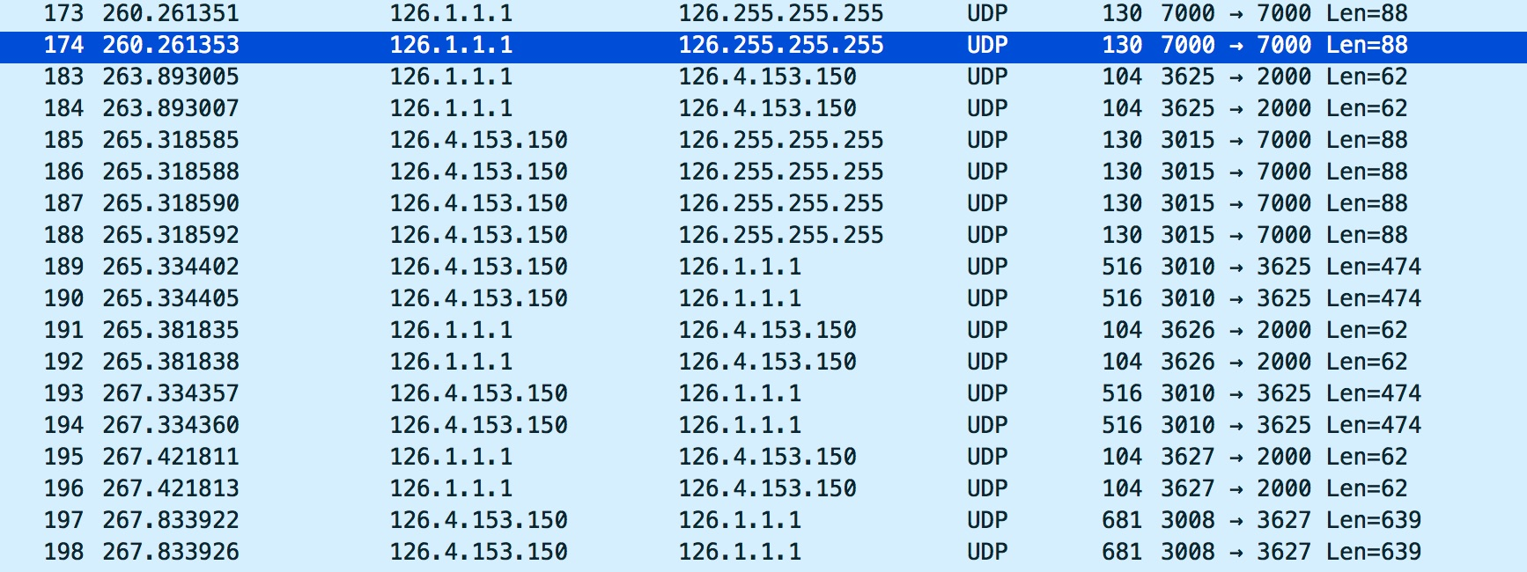
Understanding the packets: Handshake
Notes:
Ok easy enough lets make a scapy script todo this. FAIL more info in packets that matter
Make it clear that the fake S, S/A, A is still UDP and connectionless, just represents a handshake type of structure.

Slide 38
Understanding the packets: Handshake
CMS Opens Channel “SYN”
Notes:
Ok easy enough lets make a scapy script todo this. FAIL more info in packets that matter
Make it clear that the fake S, S/A, A is still UDP and connectionless, just represents a handshake type of structure.

Slide 39
Understanding the packets: Handshake
CMS Opens Channel “SYN”
PM
“SYN, ACK”
Notes:
Ok easy enough lets make a scapy script todo this. FAIL more info in packets that matter
Make it clear that the fake S, S/A, A is still UDP and connectionless, just represents a handshake type of structure.

Slide 40
Understanding the packets: Handshake
CMS Opens Channel “SYN”
PM
“SYN, ACK”
Notes:
Ok easy enough lets make a scapy script todo this. FAIL more info in packets that matter
Make it clear that the fake S, S/A, A is still UDP and connectionless, just represents a handshake type of structure.

Slide 41
Understanding the packets: Handshake
CMS Opens Channel “SYN”
PM
“SYN, ACK”
CMS
“ACK”
Notes:
Ok easy enough lets make a scapy script todo this. FAIL more info in packets that matter
Make it clear that the fake S, S/A, A is still UDP and connectionless, just represents a handshake type of structure.

Slide 42
Understanding the packets: Handshake
CMS Opens Channel “SYN”
PM
“SYN, ACK”
CMS
“ACK”
PM
What port you want to use?
Notes:
Ok easy enough lets make a scapy script todo this. FAIL more info in packets that matter
Make it clear that the fake S, S/A, A is still UDP and connectionless, just represents a handshake type of structure.

Slide 43
Understanding the packets: Handshake
CMS Opens Channel “SYN”
PM
“SYN, ACK”
CMS
“ACK”
PM
What port you want to use?
CMS
This one! 3627
Notes:
Ok easy enough lets make a scapy script todo this. FAIL more info in packets that matter
Make it clear that the fake S, S/A, A is still UDP and connectionless, just represents a handshake type of structure.

Slide 44
Understanding the packets: Handshake
CMS Opens Channel “SYN”
PM
“SYN, ACK”
CMS
“ACK”
PM
What port you want to use?
CMS
This one! 3627
PM
Ok, Here some Data!
Notes:
Ok easy enough lets make a scapy script todo this. FAIL more info in packets that matter
Make it clear that the fake S, S/A, A is still UDP and connectionless, just represents a handshake type of structure.

Slide 45
Handshake hacked!!
Notes:
Explain how the “SYN,ACK” packet is sent continuously on a time interval and therefore we need to take a closer look at it. It caused the fail

Slide 46
Handshake hacked!!
Notes:
Explain how the “SYN,ACK” packet is sent continuously on a time interval and therefore we need to take a closer look at it. It caused the fail

Slide 47
Closer look at “Syn,ack” packets
Notes:
Why do we care more about packets from PM than CMS?
Data is coming from PM, CMS is receiving it.
Goal is to emulate or inject

Slide 48
Closer look at “Syn,ack” packets
Notes:
Why do we care more about packets from PM than CMS?
Data is coming from PM, CMS is receiving it.
Goal is to emulate or inject

Slide 49
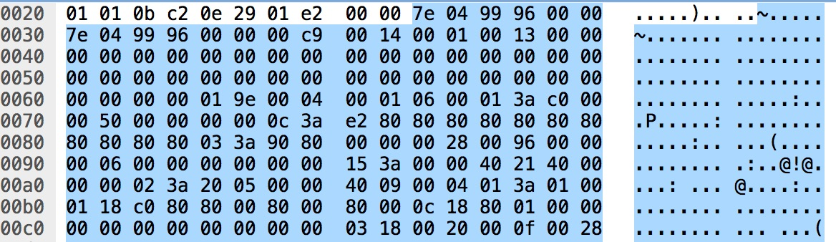
Closer look at “Syn,ack” packets
Notes:
Why do we care more about packets from PM than CMS?
Data is coming from PM, CMS is receiving it.
Goal is to emulate or inject

Slide 50
Emulation or replay attack Steps
Send broadcast packets to allow cms to detect device
Perform handshake
Accounting for port changes and counters
Send captured heartbeat packets

Slide 51
Emulation Demo

Slide 52
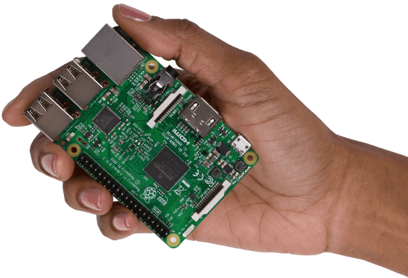
Impact scenario
Loaded onto raspberry pi
Plug PI into Ethernet jack
Can harm patient unnoticed

Slide 53
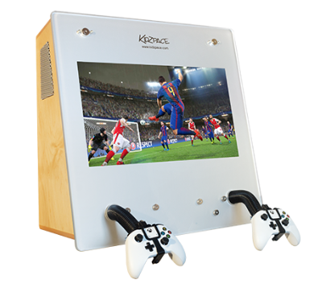
Impact scenario
Loaded onto raspberry pi
Plug PI into Ethernet jack
Can harm patient unnoticed

Slide 54

Impact scenario
Loaded onto raspberry pi
Plug PI into Ethernet jack
Can harm patient unnoticed
Notes:
By emulating data – the patient will be presumed to be in the room resting thus allowing a potential physical attack. A momentary disconnection of the ECG will go unnoticed as this happens often due to patient movement or changing clothes and as long as it is reconnected, will not cause an alert. Thus a physical attack as in patient abduction, assassination, etc without notice. There is particular vulnerability during evening / overnight shifts when hospital staffing is less.

Slide 55
What about modifying existing data?
Handshake is already completed
Data port? Respond packet port?
Arp Spoof
Send new data on same port

Slide 56
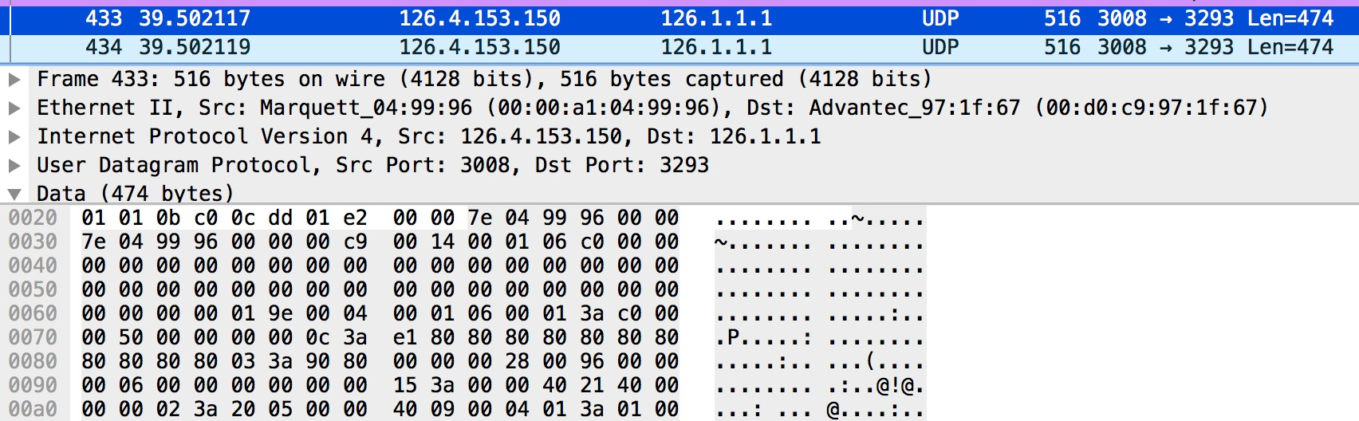
Injection
Heartbeat
Value
(80 base 10)

Slide 57
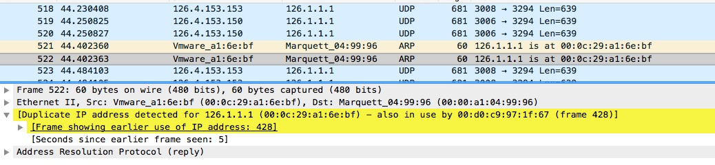
Injection
Kali Box MAC
Heartbeat
Value
(80 base 10)

Slide 58
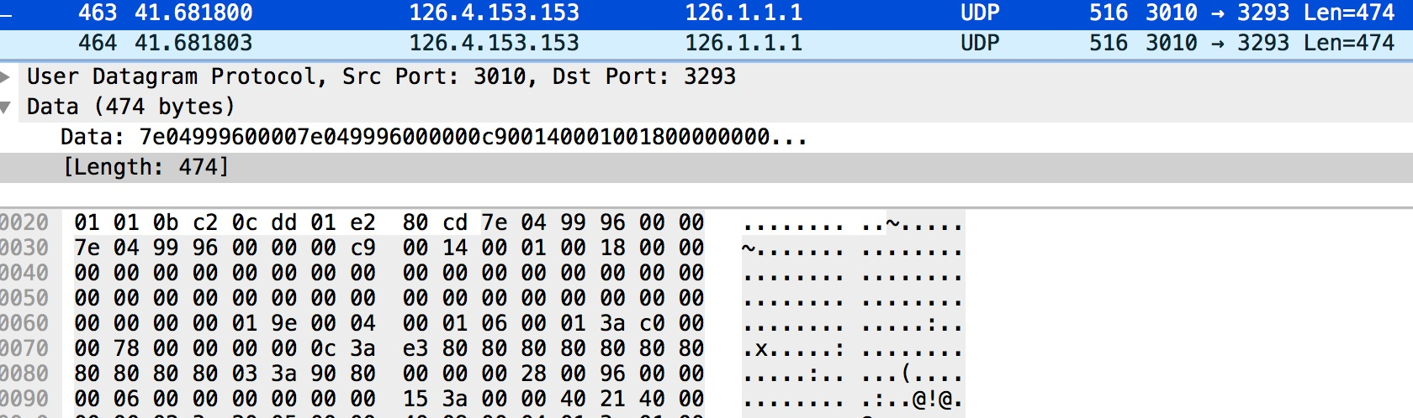
Injection
Heartbeat
Value
(120 base 10)

Slide 59
Demo Packet Injection

Slide 60
Demo Packet Injection 2

Slide 61
Impact scenario
“Fictitious cardiac rhythms, even intermittent, could lead to extended hospitalization, additional testing, and side effects from medications to control heart rhythm and/or prevent clots. The hospital could also suffer resource consumption.”
- Dr. S. Nordeck
Power of misinformation
Unconscious patient
Reliance on technology
Smaller changes, larger impact
Notes:
As you saw in the demos, it is possible to inject any rhythm we desire. The 30 beats per minute as well as 180 beats per minute are not sustainable with life. While we only showed a few rhythms, we can send any rhythm we desire. When an arrythmia is detected, as you saw in the video, alarms are set off, the central monitoring station begins recording, and the technician or nurse will ultimately call the physician to alter them of the abnormal heart rhythm.
The physician will generally see the patient at bedside and notice the bedside monitor doesn’t agree with the central monitoring station. Furthermore, the patient will be able to inform the physician they have no symptoms. Therefore there is little likelihood for immediate harm in this setting because generally only an EKG and perhaps some labs would be ordered in the meantime between the physician being notified and seeing the patient.
No consider if the rhythm is not sustained, the patient is unconscious or on a ventilator, or perhaps demented and not reliable to answer questions. The physician is then forced to rely on what the monitor is showing.

Slide 62
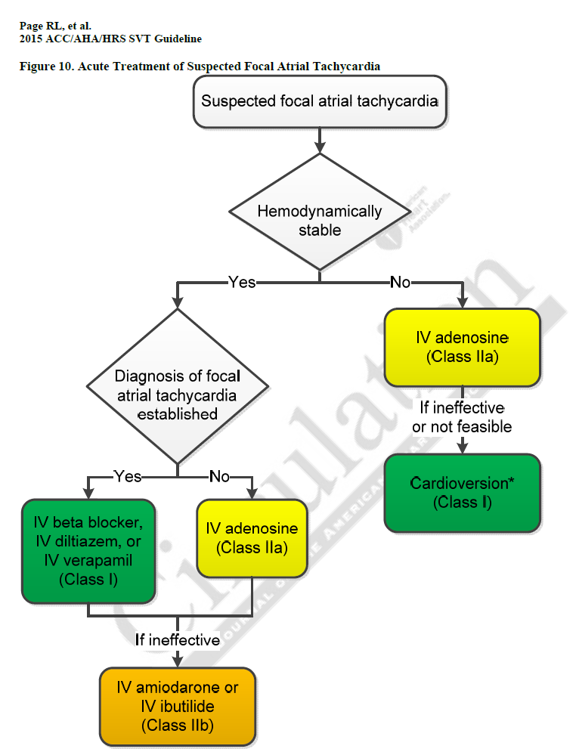
Amer. Heart assoc. & Amer. College of cardiology – arrhythmia management guidelines
Notes:
As a physician we like evidence based medicine and this is an example from the AHA and ACC for the management of cardiac arrythmias. This flowchart is for atrial tachycardia. Consider if this rhythm was intermittently sent to the central station in short runs of say 30-60 seconds. The physician would ask the RN what the BP is and if the patient is symptomatic (i.e. palpitations, headache, chest pain, dizzy, etc). In this case, by the time the RN got to the room, the patient’s monitor shows NSR and the BP is good. Patient denies symptoms. Therefore the patient is stable but continues to have intermittent A-tach. This is confirmed by the central monitoring station because the EKG is printed showing several short runs of a-tach. The patient would then be placed on a medication to block this rhythm and if unsuccessful escalated to stronger medications. The side effects of these medications are fairly significant and can cause harm, especially when not needed.

Slide 63
Amer. Heart assoc. & Amer. College of cardiology – arrhythmia management guidelines
Fictitious intermittent cardiac rhythms
Notes:
For example, the rhythm is a non sustained atrial tachycardia. The physician would ask the RN what the BP is and if the patient is symptomatic (i.e. palpitations, headache, chest pain, dizzy, etc). In this case, by the time the RN got to the room, the patient’s monitor shows NSR and the BP is good. Patient denies symptoms. Therefore the patient is stable but continues to have intermittent A-tach. This is confirmed by the central monitoring station because the EKG is printed showing several short runs of a-tach. The patient would then be placed on a medication to block this rhythm and if unsuccessful escalated to stronger medications. The side effects of these medications are fairly significant and can cause harm, especially when not needed.

Slide 64
Amer. Heart assoc. & Amer. College of cardiology – arrhythmia management guidelines
Fictitious intermittent cardiac rhythms
Blood Pressure Normal?
Notes:
For example, the rhythm is a non sustained atrial tachycardia. The physician would ask the RN what the BP is and if the patient is symptomatic (i.e. palpitations, headache, chest pain, dizzy, etc). In this case, by the time the RN got to the room, the patient’s monitor shows NSR and the BP is good. Patient denies symptoms. Therefore the patient is stable but continues to have intermittent A-tach. This is confirmed by the central monitoring station because the EKG is printed showing several short runs of a-tach. The patient would then be placed on a medication to block this rhythm and if unsuccessful escalated to stronger medications. The side effects of these medications are fairly significant and can cause harm, especially when not needed.

Slide 65
Amer. Heart assoc. & Amer. College of cardiology – arrhythmia management guidelines
Fictitious intermittent cardiac rhythms
If PM monitor was modified
Blood Pressure Normal?
Notes:
For example, the rhythm is a non sustained atrial tachycardia. The physician would ask the RN what the BP is and if the patient is symptomatic (i.e. palpitations, headache, chest pain, dizzy, etc). In this case, by the time the RN got to the room, the patient’s monitor shows NSR and the BP is good. Patient denies symptoms. Therefore the patient is stable but continues to have intermittent A-tach. This is confirmed by the central monitoring station because the EKG is printed showing several short runs of a-tach. The patient would then be placed on a medication to block this rhythm and if unsuccessful escalated to stronger medications. The side effects of these medications are fairly significant and can cause harm, especially when not needed.

Slide 66
Amer. Heart assoc. & Amer. College of cardiology – arrhythmia management guidelines
Fictitious intermittent cardiac rhythms
If PM monitor was modified
Blood Pressure Normal?
Notes:
For example, the rhythm is a non sustained atrial tachycardia. The physician would ask the RN what the BP is and if the patient is symptomatic (i.e. palpitations, headache, chest pain, dizzy, etc). In this case, by the time the RN got to the room, the patient’s monitor shows NSR and the BP is good. Patient denies symptoms. Therefore the patient is stable but continues to have intermittent A-tach. This is confirmed by the central monitoring station because the EKG is printed showing several short runs of a-tach. The patient would then be placed on a medication to block this rhythm and if unsuccessful escalated to stronger medications. The side effects of these medications are fairly significant and can cause harm, especially when not needed.

Slide 67
Amer. Heart assoc. & Amer. College of cardiology – arrhythmia management guidelines
Fictitious intermittent cardiac rhythms
If PM
was modified
Blood Pressure Normal?
Medications Administered
Notes:
The biggest concern is if we could affect the bedside patient monitor – if this was the case and we showed A-tach with hypotension – we would give a medication which temporary stops & resets the heart. We would try this twice and then proceed to cardioversion. This is the “Clear” and “shock” people are familiar with from TV. It’s incredibly painful, can cause blood clots , and can stop the heart completely or put into a different non-life sustaining rhythm such as ventricular fibrillation especially if the shock is not properly administered. In short, this could be disastrous.

Slide 68

Mitigations
Encryption
Authentication/Authorization
Isolation
Network access controls
Physical access control
Notes:
Isolated private network with only critical monitoring devices connected
Properly architected and configured for isolation
Since a physical attack, the isolation doesn’t really mitigate the issue, it only mitigates it from becoming a remote attack
Network access controls are employed
Physical access control

Slide 69
Other Considerations
Attacker would require full knowledge of all aspects of the protocol and must create a full consistent set of parameters to avoid detection
Local monitor continues to show the true state of the patient and cannot be altered by this attacker
Monitors do not require a network to function properly
Notes:
Attacker would require full knowledge of all aspects of the protocol and must create a full consistent set of parameters to avoid detection
Discrepancies between parameters and waveforms would be obvious
Local monitor continues to show the true state of the patient and cannot be altered by the attacker
Monitors do not require a network to function properly

Slide 70
Special thanks
Shaun Nordeck, MD
Charles McFarland
McAfee Production team
ATR

Slide 71
Questions?

